Slide 1
Business and Management Studies
Economic Policy and Market Regulation
Prof. Dr. Stefan Kooths
UE Berlin
Summer term 2020
www.kooths.de/bits-ep

Slide 2
Contact data
Prof. Dr. Stefan Kooths
Head of Forecasting Center
Kiel Institute for the World Economy
Office Berlin
In den Ministergärten 8
10117 Berlin
030/2067-9664
stefan.kooths@ue-germany.com
www.kooths.de

Slide 3
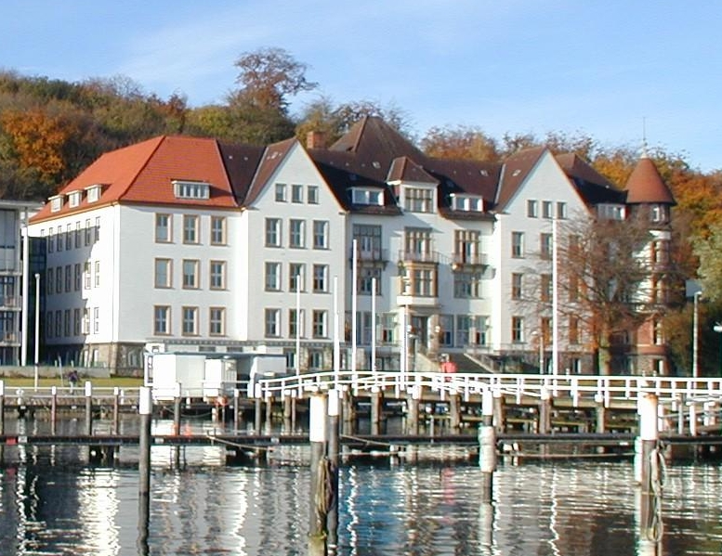
Kiel Institute for the World Economy (est. 1914)
Forecasting Center

Slide 4
Outline
Introduction and Overview
Human Action and Social Coordination
Economic Order and Principles of Policy Making
Market Mechanisms and Government Interventions
Externalities and Public Goods
Competition and Antitrust Policy
Information Deficiencies
Redistribution and Social Policy

Slide 5
Outline
Introduction and Overview
Human Action and Social Coordination
Economic Order and Principles of Policy Making
Market Mechanisms and Government Interventions
Externalities and Public Goods
Competition and Antitrust Policy
Information Deficiencies
Redistribution and Social Policy

Slide 6
Analysis of economic policy making: Key questions
Why?
How?
What are the outcomes?
Framework/reference scheme: Free market system

Slide 7
The “free-market prejudice”
Voluntary exchange implies mutual gains from trade.

Slide 8
Economics as a coordination problem (O'Driscoll)
Humans as social animals/division of labor
Analysis of alternative coordination mechanisms
(markets vs. hierarchies)

Slide 9
Good and bad economics
The bad economist sees only …
  … what immediately strikes the eye.
  … the direct consequences of a proposed course.
  … what the effect of a given policy has been or will be on one particular group.
The good economist also …
  … looks beyond.
  … looks at the larger and indirect consequences.
  … inquires what the effect of the policy will be on all groups.
Source: H. Hazlitt (2008)

Slide 10
Positive vs. normative analysis
Positive economics
  Economist as an observer
  Explanation of cause and effect
Normative economics
  Economist as an advisor based on fundamental values
  Judgmental knowledge (requires making assumptions explicit)
Political economics
  Analysis of politicians/bureaucrats/pressure groups
  Public Choice/New Institutional Economics

Slide 11
Markets vs. politics/morals
Market system: Coordination mechanism (instrument)
  Usefulness basically open to scientific analysis
  But: Links between personal freedom and market system
Politics/morals: Definition of targets (normative)
  Legitimation cannot be established by economic science
  Economics: Looking for best means to reach specific targets and determining opportunity costs/trade-offs

Slide 12
Methodological individualism (1/2)
General method
  Individuals as point of departure for economic analysis
  Explaining social processes via actions of involved persons
Individuals …
  … are diverse
  … have exogenous preferences
  … are capable of acting on their own
  … follow their vested interest
Subjectivism
  Individual preferences
  No scientific inter-subjective comparisons of utility

Slide 13
Methodological individualism (2/2)
Individuals have ends, groups don’t
  Collective entities (countries, societies, classes etc.) are mental models, they do not exist independently from their individual members
Methodological individualism
  Only individuals act …
  … but not in isolation ⇨ society formed by human interaction
  Explaining social phenomena bottom up, starting from the analysis of individual human actors (as basic elements for the social sciences)

Slide 14

Self-interest
Assumption of self-interested behavior (= free will)
  Makes individual ends relevant for economic analysis
  Makes no judgement whatsoever on morality of individual ends
Does Mother Teresa fit
into the paradigm of human action?

Slide 15
Micro/macro vs. partial/total analysis
Considering interdependencies
(Feedbacks)
Partial models
Total models
Macro level
Macroeconomic
partial analysis
Macroeconomic
total analysis
Aggregation
Micro level
Microeconomic
partial analysis
Microeconomic
total analysis

Slide 16
Reading
Literature
  Acemoglu, D., and J. A. Robinson (2013): Why Nations Fail – The Origins of Power, Prosperity and Poverty. London: Profile Books.
  Bénassy-Quéré, A., B. Coeré, P. Jacquet and J. Pisani-Ferry: Economic Policy – Theory and Practice. Oxford University Press: Oxford and New York, 2010.
  Hazlitt, H. (2008): “Economics in One Lesson”, Ludwig von Mises Institute: Auburn/Alabama.
  Mankiw, N. G. and M. P. Taylor (2014): „Economics“, 3rd Edition, Cengage Learning.

Slide 17
Outline
Introduction and Overview
Human Action and Social Coordination
Economic Order and Principles of Policy Making
Market Mechanisms and Government Interventions
Externalities and Public Goods
Competition and Antitrust Policy
Information Deficiencies
Redistribution and Social Policy

Slide 18
Point of departure
Man acts.

Slide 19

Human Action
Subjective uneasiness ⇨ purposeful action
Action = Influencing circumstances of one’s life
Humans as universal entrepreneurs
  Decision maker
  Explorer (search for new means)
Ludwig von Mises (1881 – 1973)
Nationalökonomie – Theorie des Handelns und Wirtschaftens (1940)
http://mises.org/document/3250

Slide 20
Means, ends, and valuation
Speculation
Means
End
Effect
Speculation
Means
End
Subjective
judgment
Selection
Valuation
Reverse value imputation: The end does not „sanctify “ the means, but it values it!
Limited knowledge: Action under uncertainty (= speculation)
Rationality/„homo oeconomicus“: Humans do not purposefully act against their aims
Allows for meaningful interpretation by others (= science)

Slide 21
The fundamental allocation problem
Human needs
  Subjectively felt uneasiness (reason for action)
  Generally unlimited
Goods
  Means for (direct or indirect) satisfaction of a need
  Generally limited
Scarcity (allocation problem)
  Not all needs can be fully satisfied
  Selection inevitable
    Ranking needs
    Matching with disposable means (production possibilities)
  Economic growth: Reduction of „uneasiness “
  (more satisfaction by expanding the pool/productivity of means)

Slide 22
Alternative allocation mechanisms
Violence (military campaigns, robber barons)
Discrimination (Sex, Nationality, Age, …)
Greyhound racing („First come, first served“)
Communism („Each according to his/her need”)
Egalitarianism („Each the same“)
Market (competitive exchange mechanism)
  Property rights
  Voluntary exchange
  „Each according to his/her preferences and performance“
  (ability-to-pay resulting from market income = valuation by others)

Slide 23
Means, ends, arbitrage, speculation, and entrepreneurship
Speculation
Means
End
Expected effect
Speculation
Means
End
Subjective
judgment
Selection
Valuation
Factor markets:
Prices of resource services
(Future) product markets:
Prices of consumer goods
Arbitrage
Imperfect communication
between two markets
(price of bundle of inputs ≠ price of consumption good)

Slide 24
The market signal system: Profits, Losses, Bankruptcy
Profits
  Revenues (value creation) > Costs (value destruction)
  Net creation of value
  Agent stays in the game, activity can be expanded
Losses
  Revenues < Costs
  Net destruction of value
  Yellow card (warning): activity should be reduced/modified
Bankruptcy
  Revenues << Costs
  Net value destruction ongoing/at large scale
  Red card (sending-off): activity must stop

Slide 25
Workable economic coordination
What are allocation mechanisms expected to do?
Static functions
  Consumer sovereignty
  Efficient factor allocation
  Performance-based income distribution
Dynamic functions
  Flexible adjustment to changing conditions
  Technological progress/innovations
Coordination efficiency

Slide 26
Refresher course
Goods and value

Slide 27
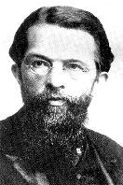
Nature of goods
Human need
+
Causal connection to satisfy such a need
+
Human knowledge of this causal connection
+
Sufficient command of the thing
Subjectivist theory of goods
  Good-character depends on human judgment
  Quality/value not an objective property of the good
Human perception of need satisfaction
Carl Menger (1840 – 1921)
Grundsätze der Volkswirtschaftslehre (1871)
Principles of Economics (1976)

Slide 28

Letters of indulgence: An economic good?
“As soon as money in the coffer rings, the soul from purgatory’s fire springs.”

Slide 29
Free goods vs. economic goods
Economic goods
  Availability < requirements
  Scarcity
Free goods
  Availability ≥ requirements
  Abundance
Distinction depends on circumstances and knowledge
  Economic character nothing inherent in goods
  Only the relationship between availability and requirements matters
Increase of needs
Population growth
Technological progress

Slide 30
The foundations of modern value theory
Theory of value
Subjectivism
Marginalism

Slide 31
Value as a trilateral relation
Good A
(option A)
Person
Good B
(option B)
Value = opportunity cost
(trilateral relation between human actor and 2 alternative options)

Slide 32
Marginalism
Thinking at the margin (= in relevant terms)
The concept of value refers to the relevant unit at the margin, not to abstract classes of goods (e.g. bread-as-such)
All-or-nothing is typically not the relevant alternative
  Bread-as-such does not have a meaningful value
  Concrete units matter for human action: +/- a leaf (or slice) of bread
BUT: Marginal analysis ≠ infinitesimal calculus
Value = Importance of the need whose satisfaction depends on the availability of the marginal quantity of a good

Slide 33

Subjectivism and marginalism put together: Böhm-Bawerk’s famous example
A pioneer farmer has five sacks of grain, with no way of selling them or buying more. The ranked possible uses are:
Basic feed for himself (survival)
Food to build strength
Food for his chickens for dietary variation
Ingredient for making whisky
Feeding his parrots for his amusement
Value of one sack of grain?
Farmer’s value scale (= priority list)

Slide 34
The law of diminishing marginal value
Marginal value
= value of the least valued need that a unit of a homogeneous pool of goods can serve
Law of diminishing marginal value:
Value is generally diminishing at the margin
  All units of a good can in principle be applied for the same purposes. If one unit is lost the least important need will be given up (scarcity).
  It does not matter which unit is given up, since individuals can always reorganize the goods under their control.
  Hence, as the number of units owned increases (decreases), the marginal value of all goods declines (increases).
Implication of human action, not a psychological/physiological law

Slide 35
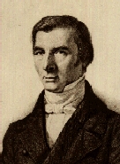
Opportunity cost and relevant alternatives
Frédéric Bastiat (1801 – 1850)
Ce qu' on voit et ce qu' on ne voit pas (1850) [http://bastiat.org/fr/cqovecqonvp.html]
That Which is Seen, and That Which is not seen [http://bastiat.org/en/twisatwins.html]
The costs of an action lie in the things that could have been done instead
Many things of economic relevance never see the light of day
Identifying relevant alternatives
Heart of economic analysis: Cost = opportunity cost

Slide 36

The Broken Window Fallacy
http://www.youtube.com/embed/QG4jhlPLVVs

Slide 37
Outline
Introduction and Overview
Human Action and Social Coordination
Economic Order and Principles of Policy Making
Market Mechanisms and Government Interventions
Externalities and Public Goods
Competition and Antitrust Policy
Information Deficiencies
Redistribution and Social Policy

Slide 38
Role of governments and policy level
Enabling market processes
(design of economic order)
and
changing market outcomes
(interfering with market processes)
Constitutional level
(abstract rules)
Interventional level
(concrete measures)

Slide 39
Property rights and the primary role of government
Property rights
  Usus
  Abusus
  Usus fructus (includes: accountability!)
Role of government:
Defining and guaranteeing property rights (legal framework)

Slide 40

Economic order
Inclusive vs. extractive institutions

Slide 41
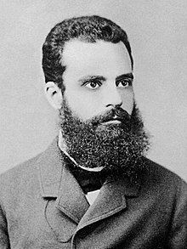
Pareto rule
Pareto superiority (or Pareto improvement)
  Action that makes at least one individual better off without making anyone else worse off
Pareto efficiency (or Pareto optimality)
  Situation where no more Pareto superior actions exist
Vilfredo Pareto (1848–1923)
Manual of Political Economy, 1906

Slide 42
Pareto rule: Diagrammatical exposition

Slide 43
Pareto efficiency and Kaldor-Hicks criterion
Kaldor-Hicks criterion for government interventions
  Intervention leads to winners and losers
  Winners become so much better off that they can compensate the losers

Slide 44
Fields for policy making: Allocation, redistribution, and stabilization
Allocation
  Improving economic efficiency
  Design of overall framework (economic order, property rights) ⇨ Theory of markets/competition
  Industry-specific regulations ⇨ Theory of market failures
Redistribution
  Changing the distribution of disposable income (primary vs. secondary income distribution)
  Tax-transfer-system, social security system
Stabilization (macro level)
  Fostering steady growth, full employment, price stability, external equilibrium
  Fiscal policy, monetary policy/currency system, financial regulation
Search for Pareto-improvements
Chapter 5 to 7
Chapter 8
Class on Macroeconomics/International Economics

Slide 45
Market failure (= coordination failure)
Individual incentives for rational behavior
are incompatible with socially desirable market outcomes
(individual rationality ≠ social rationality)

Slide 46
Allocative efficiency: Categories of market failures
Chapter 5
Technological externalities
“Imperfect competition”/Natural monopolies
Information deficiencies (imperfect or asymmetric information)
Instability (deficient adjustment processes in individual markets)
[Non-rationality]
Chapter 6
Chapter 7

Slide 47
Transaction costs
Ex-ante transaction costs
  Search
  Negotiation
  Contracting
Ex-post transaction costs
  Implementation
  Monitoring
  Adjustment
Using the market is not for free
(BUT: so is hierarchical/central planning)

Slide 48
Policy making
Market failure vs. government failure
(real world markets vs. real world politics)

Slide 49
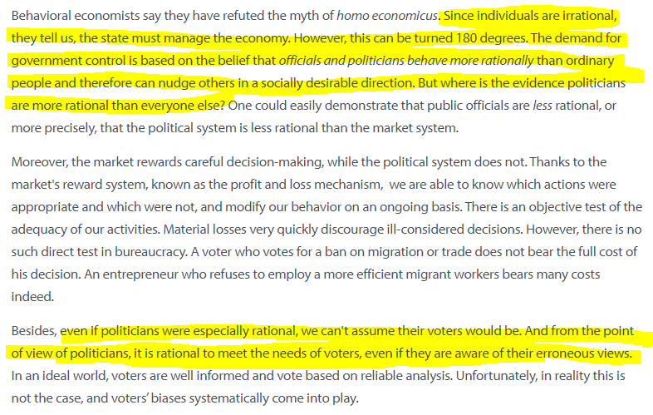
“Less Policy, More Market” (Arkadiusz Sieroń)

Slide 50
Categories of government failures
Crowding-out
  Substituting private spending for public spending
Arrow paradox
  Impossibility of collective action (circular preferences)
Cobra effect
  Unintended consequences (perverse incentives, lack of knowledge)
Rent-seeking
  Government power falling victim to vested interests (regulatory arbitrage)

Slide 51
Collective “action” and average “behavior” of groups: The Arrow paradox
Person | Ranking of alternatives A, B, C
1 | A > B > C
2 | B > C > A
3 | C > A > B
Voting | Results
A vs. B | 2:1 A > B
B vs. C | 2:1 B > C
C vs. A | 2:1 C > A
A > B > C > A

Slide 52

Incentives and government interventions: The Cobra effect
Intentions
vs.
outcome

Slide 53
Rent seeking ( public choice, new political economy)
Rent = income without creating additional value
Influence on governmental action by vested interests
Dysfunctional income redistribution via the public sector
Public choice theory
Anthony Downs
  An Economic Theory of Democracy (1957)
James M. Buchanan, Gordon Tullock
  The Calculus of Consent: Logical Foundations of Constitutional Democracy (1962)
Mancur Olson
  The Logic of Collective Action (1965)

Slide 54
Interventionist spiral
Policy target ⇨ Regulation 1
  Unintended consequences
    Regulation 2
      Unintended consequences
        Regulation 3
          Unintended consequences
            Regulation 4
              …
Market
economy
interventionism
Socialism

Slide 55
Principle of Subsidiarity: The Triple-I Criteria
“A central authority should have a subsidiary function, performing only those tasks which cannot be performed at a more local level.” (Oxford English Dictionary)
Information
Instruments
Incentives
Action level
  World
  Country group
  Nation state
  Federal state
  Region
  District
  Compulsory association
  Private association
  Individual level
Government intervention
(coercion)
Market exchange
(voluntary
cooperation)

Slide 56
The extended Tinbergen rule for government interventions
One policy target
One specific tool (policy instrument)
One independent authority (in case of target conflicts)

Slide 57



The extended Tinbergen rule for government interventions
One policy target
One specific tool (policy instrument)
One independent authority (in case of target conflicts)

Slide 58
Potential room for improving social coordination: The two-stage burden of proof
Intervention analysis: Market vs. hierarchy (central planning)
  Significant market failure?
  Market failure > government failure?
  (comparing relevant alternatives)
    Information problem
    (getting/distributing data, value problem)
    Incentive/bureaucracy problem
    (individual utility vs. realization of the plan)
    Financing/spillovers to other fields
    (distortions on other markets)
  Intervene only, if (1) and (2)
    Default: Market-based coordination (free-market prejudice)
    Minimally invasive operations (market-compatible solutions)

Slide 59
Regulation vs. deregulation: An ongoing debate
Regulatory design is technology-dependent
Competing paradigms for economic policy making
Sunset legislation

Slide 60
Fundamental question for social organization
Markets (voluntary cooperation)
vs.
hierarchies (coercion)

Slide 61
Outline
Introduction and Overview
Human Action and Social Coordination
Economic Order and Principles of Policy Making
Market Mechanisms and Government Interventions
  Market-based coordination and welfare economics
  Price controls
  Taxes
Externalities and Public Goods
Competition and Antitrust Policy
Information Deficiencies
Redistribution and Social Policy

Slide 62
Demand theory without psychology: Law of marginal utility
Marginal
utility
1st best use
2nd best use
3rd best use
Demand
4th best use
5th best use
6th best use
7th best use
Quantity

Slide 63

Supply theory without “production cost”: Cost as universal social opportunity cost
Part II, Section II, Chapter 2
Marginal
utility
Supply
last-9th best use …
… of available resources
(relative to a given body of
technological knowledge)
last-8th best use
last-7th best use
last-6th best use
last-5th best use
last-4th best use
last-3rd best use
last-2nd best use
last-1st best use
last best use
Quantity
Schumpeter, A.: Das Wesen und der Hauptinhalt der Theoretischen Nationalökonomie. Leipzig 1908: 213ff.

Slide 64
Market coordination for resource allocation
Marginal
utility
D
S
1st best use
last-9th best use
2nd best use
last-8th best use
last-7th best use
3rd best use
last-6th best use
last-5th best use
4th best use
5th best use
last-4th best use
last-3rd best use
last-2nd best use
6th best use
last-1st best use
7th best use
last best use
Quantity

Slide 65
Real world markets
Short side of the market dominates
Disequilibrium
(arbitrage trends towards coordination)
Equilibrium
(full coordination)
  Maximum trade volume
  Maximum social welfare
Price
D
S
x

Slide 66
Conditions for „perfect“ competition
Atomistic market structure
  Large number of small buyers and sellers (no market power)
  Price taker/autonomous decisions
Rationality
  Consumers/households: Utility maximization
  Producers/enterprises: Profit maximization
  Self-interest with fair means (no opportunistic behavior)
Homogenous goods
  No personal/spatial/physical preferences
  No indivisibility
Stationary world
  Given resources, constant technology
  No growth analysis, no process/product innovations
World without frictions
  Zero transaction costs (no costs for making an exchange of goods)
  Perfect factor mobility (unrestricted market entry/exit)
Freedom of choice
  No involuntary/compulsory transactions
  No technological external effects
Perfect information/total transparency
  Full knowledge/free information about alternatives and prices
  No uncertainty
Infinite speed of response
  Focus on equilibrium analysis
  Transactions only at equilibrium prices (no “false” trading)

Slide 67
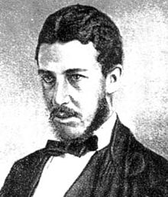
„Law of one price“
Undifferentiated products ⇨ one price
  No market power (atomistic market)
  No frictions (transaction cost)
  Perfect information
  Infinite response time (equilibrium view)
  Rationality
Market mechanism
  Competition
  Arbitrage
William Stanley Jevons (1835–1882)
The Theory of Political Economy, 1871

Slide 68
The 2-2-2 model
Two consumers: A and B
Two products: X and Y
Two factors: L and K

Slide 69
Utility and indifference curves
Indifference curve = constant level of utility of alternative combinations of x and y
Negative sloped, shape follows from law of diminishing marginal utility
U1 < U2 < U3
y
C4
C3
C2
C1
U₃
U₂
U₁
0_{A}
x

Slide 70
Criteria 1: Efficiency of exchange (Edgeworth box and contract curve)
y (oranges)
40
contract curve
y
D4
D3
15
U₃
D5
D2
12
D1
U₂
10
Total quantities:
Y = 40 oranges
X = 50 apples
U₃
U₁
0_{A}
U₂
x (apples)
34
30
35
U₁
50
0_{B}
x

Slide 71
Indifference curves and budget line
B = 200 Euro
p_{x} = 5 Euro/apple
p_{y}= 2 Euro/orange
B = p_{x}*x + p_{y}*y
y
100
y = B/p_{y} - p_{x}/ p_{y}*x
C1
C2
C3
U₃
U₂
U₁
0_{A}
40
x

Slide 72
Criteria 2: Efficiency of factor use (efficiency line and production-possibility frontier)

Slide 73
Criteria 3: Optimal composition of production (consumer sovereignty)

Slide 74
Equilibrium: Market clearing and social welfare

Slide 75
Fundamental theorems of welfare economics
Theorem 1:
Competitive markets tend toward an efficient allocation of resources (= fulfill criteria 1 to 3)
Theorem 2:
Any particular Pareto-efficient outcome can be achieved via lump-sum wealth redistributions and then letting the market take over

Slide 76
The markets’ navigation system
Prices as universal information carriers

Slide 77
Primary income distribution

Slide 78
Flexible adjustment to changing conditions

Slide 79
Technological progress

Slide 80
Market process view: Product life cycle (market phases)
Ernst Heuß (1965): Allgemeine Markttheorie
sales
experimentation
expansion
maturity
stagnation/
decline
time
Static efficiency
Dynamic efficiency

Slide 81
Impossibility of calculation under Socialism (Mises)
Revealed preferences (interface to subjective valuations)
Private property and incentives for performance and risk taking
Market prices cannot be simulated

Slide 82
Outline
Introduction and Overview
Human Action and Social Coordination
Economic Order and Principles of Policy Making
Market Mechanisms and Government Interventions
  Market-based coordination and welfare economics
  Price controls
  Taxes
Externalities and Public Goods
Competition and Antitrust Policy
Information Deficiencies
Redistribution and Social Policy

Slide 83
Price ceilings and market outcomes (example: rent controls)

Slide 84
Price floors and market outcomes (example: minimum wages)

Slide 85
Escaping price controls

Slide 86
Implicit price controls: Fixing Capacities

Slide 87
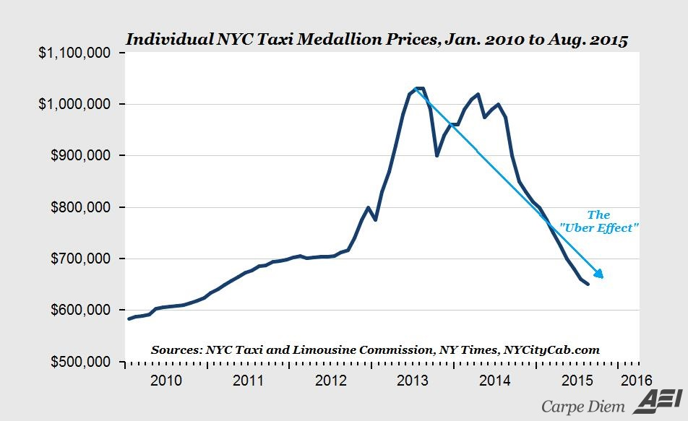
Case study: The NYC Uber effect
Source: Mark J. Perry, Schumpeterian creative destruction — the rise of Uber and the great taxicab collapse

Slide 88
Outline
Introduction and Overview
Human Action and Social Coordination
Economic Order and Principles of Policy Making
Market Mechanisms and Government Interventions
  Market-based coordination and welfare economics
  Price controls
  Taxes
Externalities and Public Goods
Competition and Antitrust Policy
Information Deficiencies
Redistribution and Social Policy

Slide 89
Taxes on sellers

Slide 90
Taxes on buyers

Slide 91
Elasticity and tax incidence: Who really pays the tax?

Slide 92
Excess burden (deadweight loss) of taxation

Slide 93
The Laffer curve: Tax rates vs. tax revenues

Slide 94

Administrative burden
Example:
Printout of all Brazilian tax laws (as of 2014)
Source: http://g1.globo.com/minas-gerais/noticia/2014/03/em-protesto-complexidade-de-leis-advogado-lanca-livro-de-75-toneladas.html

Slide 95
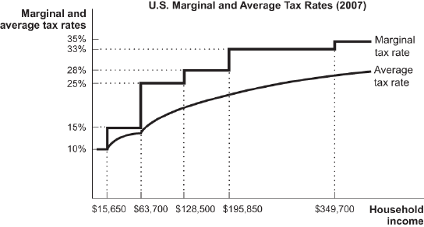
Marginal tax rates vs. average tax rates
Source: CheggStudy

Slide 96
Progressive vs. regressive taxes

Slide 97
Flat tax

Slide 98
Tax allowance: Making a flat tax progressive

Slide 99
Lump-sum taxes

Slide 100
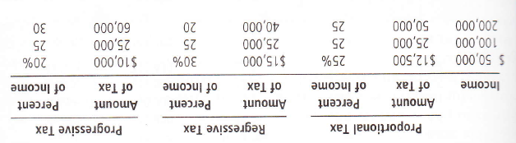
Principles of taxation: Benefits vs. ability-to-pay
Benefits principle
Ability-to-pay principle
  Horizontal equity
  Vertical equity

Slide 101
Outline
Introduction and Overview
Human Action and Social Coordination
Economic Order and Principles of Policy Making
Market Mechanisms and Government Interventions
Externalities and Public Goods
  Technological externalities
  Public goods and common resources
Competition and Antitrust Policy
Information Deficiencies
Redistribution and Social Policy

Slide 102
Externalities (external effects)
Pecuniary ⇨ Essence of competition
Technological ⇨ Challenging social benefits of voluntary exchange (spillovers upon third party)
  Inframarginal ⇨ No impact on allocation: Redistribution of welfare
  Marginal ⇨ Sub-optimal resource allocation: Affecting welfare

Slide 103
Consumption and production externalities
Exemplary externalities |  | Direction of impact
 |  | positive | negative
Sphere | Consumption | Beautiful private garden that passers-by enjoy seeing | Listening to loud music (not appreciated by neighbors)
 | Production | Pollination of fruit trees by bees of honey producers | Chemical plant polluting a river that fishermen use for fishing

Slide 104
Negative externalities: Private and social cost
Social (marginal) cost = private (marginal) cost + (marginal) external damage

Slide 105
Negative externalities: Optimal level of damage

Slide 106
Positive externalities: Private and social utility
Social (marginal) utility = Private (marginal) utility + (marginal) external benefit

Slide 107
Positive externalities: Optimal level of benefits

Slide 108
Policy instruments: Classification
Incentive-based
⇨ price mechanism (indirect impact on activity level)
Command-and-control
⇨ regulating quantities (direct fixing of activity levels)

Slide 109
Criteria for evaluating policy instruments
Effectiveness
Efficiency: Static and dynamic
Intensity of intervention

Slide 110
Moral suasion

Slide 111
Nationalization

Slide 112
Public orders

Slide 113
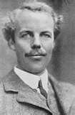
Pigouvian taxes/subsidies
Arthur Cecil Pigou (1877 – 1959)
The Economics of Welfare (1920)
BUT:
„It must be confessed, however, that we seldom know enough to decide in what fields and to what extent the State, on account of [the gaps between private and public costs] could usefully interfere with individual freedom of choice.“
(Some Aspects of the Welfare State, 1954)

Slide 114
Cap-and-trade (example: pollution permits)

Slide 115
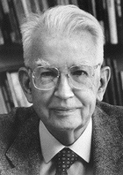
Bargaining: The Coase theorem
Ronald Coase (1910 – 2013)
The problem of social cost (1960)

Slide 116
Outline
Introduction and Overview
Human Action and Social Coordination
Economic Order and Principles of Policy Making
Market Mechanisms and Government Interventions
Externalities and Public Goods
  Technological externalities
  Public goods and common resources
Competition and Antitrust Policy
Information Deficiencies
Redistribution and Social Policy

Slide 117
Individual vs. collective goods
Classification matrix |  | Rivalry?
 |  | yes | no
Excludability? | yes | Private good | Club good
 | no | Quasi-public good | Public good
Individual goods
Collective goods
Public goods/bads:
Positive/negative technological external effects

Slide 118
Demand and supply of collective goods
Individual goods
  Horizontal aggregation of individual demand and supply schedules
  Quantity = units of goods
Collective goods
  Vertical aggregation of individual demand schedules, only one supply schedule
  Quantity = capacity/features

Slide 119
Individual vs. collective goods: Aggregating individual demand

Slide 120
Individual vs. collective goods: Aggregating individual demand

Slide 121
Managing public goods: Cost-benefit analysis
What to provide: Quantity + quality
Providing ≠ production
Cost ⇨ Market prices
Benefit ⇨ Hypothetical willingness-to-pay
Simulation of potential market outcomes (NOT trivial!)

Slide 122
Non-excludability: The free-rider problem
Ronald Coase (1910 – 2013)
The Lighthouse in Economics (1974)

Slide 123
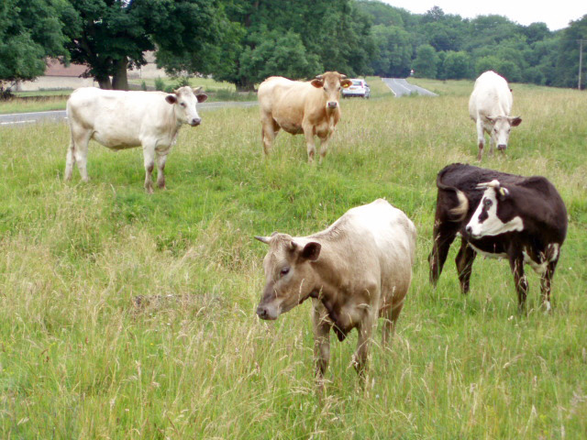
The Tragedy of the Commons: Overexploitation

Slide 124
Common resources and property rights

Slide 125
Outline
Introduction and Overview
Human Action and Social Coordination
Economic Order and Principles of Policy Making
Market Mechanisms and Government Interventions
Externalities and Public Goods
Competition and Antitrust Policy
  Competitive markets vs. market power
  Anti-competitive behavior and antitrust policies
  Natural monopolies and network effects
Information Deficiencies
Redistribution and Social Policy

Slide 126
Conditions for „perfect“ competition
Atomistic market structure
  Large number of small buyers and sellers (no market power)
  Price taker/autonomous decisions
Rationality
  Consumers/households: Utility maximization
  Producers/enterprises: Profit maximization
  Self-interest with fair means (no opportunistic behavior)
Homogenous goods
  No personal/spatial/physical preferences
  No indivisibility
Stationary world
  Given resources, constant technology
  No growth analysis, no process/product innovations
World without frictions
  Zero transaction costs (no costs for making an exchange of goods)
  Perfect factor mobility (unrestricted market entry/exit)
Freedom of choice
  No involuntary/compulsory transactions
  No technological external effects
Perfect information/total transparency
  Full knowledge/free information about alternatives and prices
  No uncertainty
Infinite speed of response
  Focus on equilibrium analysis
  Transactions only at equilibrium prices (no “false” trading)

Slide 127
“Imperfections”
Market structure*
  Polypolistic (many)
  Oligopoly (few)
  Monopoly (one)
Product characteristics
  Homogeneous
  (not differentiated)
  Heterogeneous
  (differentiated)
  As consumers see it!
*Here: Supply-side (demand-side analysis works in a similar way)

Slide 128
Categories of “imperfection”: Market structure and product differentiation
Product ⇨ Market structure | Homogeneous | Heterogeneous
Many | “Perfect” competition | Monopolistic competition
Few | Homogeneous oligopoly | Heterogeneous oligopoly
Single | Monopoly
Cartel (collective monopoly)

Slide 129
Categories of “imperfection”: Market structure and product differentiation
Product ⇨ Market structure | Homogeneous | Heterogeneous
Many | “Perfect” competition | Monopolistic competition
Few | Homogeneous oligopoly | Heterogeneous oligopoly
Single | Monopoly
Cartel (collective monopoly)

Slide 130
Monopoly
Market demand = firm demand
  Price setting (consumers choose the quantity)
  Quantity setting (consumers determine the price)
Static inefficiency
  “Marginal revenue = marginal cost” still holds
  BUT: price ≠ marginal cost (inframarginal units matter!)
  Deadweight loss

Slide 131
Monopoly diagram

Slide 132
Monopoly behavior
Price discrimination
  First-degree (perfect price discrimination)
  Second-degree (non-linear pricing)
  Third-degree (group-specific pricing)
  Separating customers according to willingness to pay
Bundling
  Packaged offers
  Reducing dispersion of willingness to pay
Two-part tariffs
  Option pricing (fixed and variable component)
  Charging consumer surplus separately

Slide 133
Monopoly: Non-linear pricing
Self-selection (in terms of quantity or quality)
Airline industry: Business and economy class tickets

Slide 134
Monopoly: Bundling
Offering all-or-nothing packages (bundles)
Software industry: Office suites

Slide 135
Monopoly: Two-part tariffs
Fixed (admission) and variable (quantity) price component
IT industry: Device (printers) and spare parts (toner)

Slide 136
Categories of “imperfection”: Market structure and product differentiation
Product ⇨ Market structure | Homogeneous | Heterogeneous
Many | “Perfect” competition | Monopolistic competition
Few | Homogeneous oligopoly | Heterogeneous oligopoly
Single | Monopoly
Cartel (collective monopoly)

Slide 137
Monopolistic competition
Small (atomistic) firms
Product differentiation
“Tangent” solution

Slide 138
Categories of “imperfection”: Market structure and product differentiation
Product ⇨ Market structure | Homogeneous | Heterogeneous
Many | “Perfect” competition | Monopolistic competition
Few | Homogeneous oligopoly | Heterogeneous oligopoly
Single | Monopoly
Cartel (collective monopoly)

Slide 139
Cartels (collective monopolies)
Collusion
Instability (“prisoner’s dilemma”)

Slide 140
Categories of “imperfection”: Market structure and product differentiation
Product ⇨ Market structure | Homogeneous | Heterogeneous
Many | “Perfect” competition | Monopolistic competition
Few | Homogeneous oligopoly | Heterogeneous oligopoly
Single | Monopoly
Cartel (collective monopoly)

Slide 141
Oligopolistic interdependence
Noticeable impact of one competitor’s action on other competitor(s)
Conduct
  Autonomous/passive
  Conjectural/strategic
Strategy
  Simultaneous (Cournot/Betrand)
  Leader/follower (Stackelberg)
  Competition (Bowley)
  Collusion
Homogeneous: Quantity
Heterogeneous: Quantity or price

Slide 142
Outline
Introduction and Overview
Human Action and Social Coordination
Economic Order and Principles of Policy Making
Market Mechanisms and Government Interventions
Externalities and Public Goods
Competition and Antitrust Policy
  Competitive markets vs. market power
  Anti-competitive behavior and antitrust policies
  Natural monopolies and network effects
Information Deficiencies
Redistribution and Social Policy

Slide 143
Anti-competitive strategies (overview)
Cartels and collusion
Abuse of dominant market position
Mergers and acquisitions

Slide 144
Anti-trust policy concepts (overview)
Laissez-faire approach
Structure approach
Regulation approach
Ownership approach

Slide 145
Per se-rule vs. rule of reason

Slide 146
Ex ante vs. ex post approach

Slide 147
Problem of the relevant market

Slide 148
Competition policy vs. industrial policy
Competition policy
  Cross-sectoral (= general) rules
  Safeguarding/strengthening competitive process ⇨ static efficiency/dynamic efficiency
Industrial policy
  Sector-specific or firm-specific rules
  Fostering competitiveness of specific firms or industries ⇨ productivity/employment
  Strategic industrial policy: Shaping the future by picking the winners
Addressing horizontal or vertical externalities
  Market power, incomplete contracting
  R&D subsidies, environmental protection, support for SME, training aid, broadband subsidies, …
conflicts

Slide 149
Outline
Introduction and Overview
Human Action and Social Coordination
Economic Order and Principles of Policy Making
Market Mechanisms and Government Interventions
Externalities and Public Goods
Competition and Antitrust Policy
  Competitive markets vs. market power
  Anti-competitive behavior and antitrust policies
  Natural monopolies and network effects
Information Deficiencies
Redistribution and Social Policy

Slide 150
Economies of scale: Sub-additivity of costs
Large fixed cost (due to indivisibility of factors)
Increasing returns to scale
  Experience curve effects
  Intensified division of labor
  Physics, stochastics
Decreasing unit cost (for relevant market size)
varies with technological change
varies with economic progress

Slide 151
Economies of scale and market size

Slide 152
Economies of scope: Multi-product firms

Slide 153
Network effect
Increasing number of users
Positive externality in consumption
Increasing usefulness

Slide 154
Platform markets: Direct and indirect network effects
Direct network effects
  Telephone, Facebook, Skype, Twitter, WhatsApp, Instagram, …
Indirect network effects (two-sided markets)
  Amazon, eBay, PayPal, AirBnB, HRS, …
Consequences/response
  Market tipping (winner-takes-all)
  Multi homing, network bridges

Slide 155
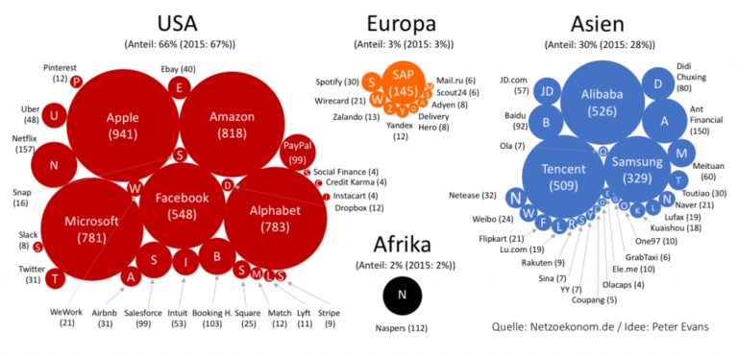
Platform markets: Big players
Top 60 global platform firms, market capitalization, bn. USD (June 2018)
Source: https://www.netzoekonom.de/2018/06/24/wert-der-plattform-oekonomie-steigt-im-ersten-halbjahr-um-1-billion-dollar/

Slide 156
Role of potential competition (contestable markets)

Slide 157
Regulation: Price-cap vs. rate-of-return

Slide 158
Auctioning

Slide 159
Competition analysis: An alternative approach
Equilibrium analysis: Static imperfections
Process analysis: Entrepreneurial competition

Slide 160

References
Kirzner, I. M. (1973): Competition and Entrepreneurship
Hayek, F. A.
  Economics and Knowledge (1937)
  The Use of Knowledge in Society (1945)
  The Meaning of Competition (1948)
  Competition as a Discovery Procedure (1968)
Mises, L. v. (1949): Human Action – A Treatise on Economics
  Chapter XV (The Market)
  Chapter XVI (Prices)
Critical assessment of orthodox competition theory and welfare economics

Slide 161
Competition and competitiveness
Process or …
  Entrepreneurial activity is per se competitive (rivalry)
  Lack of competitiveness = arbitrary barriers to entry
  Setting up the Robbinsian framework for allocative decision making
… state resulting from the process
  Perfect competition (price takers)
  Imperfection = absence of perfect elasticity (price setters)
  Decision making within a given Robbinsian framework

Slide 162
Entrepreneurial activity, market entry, and monopoly
Entrepreneurial activity
  Requires alertness
  Does not require resource ownership
Freedom of market entry
  Potential competition
  Contestable markets
  Price elasticity only temporary (pioneer’s demand = market demand)
Barriers to entry
  Regulatory (governmental intervention)
  Restricted ownership of resources (blocked access to inputs)
  Monopoly (≠ control over the product)
  Diversion of entrepreneurial process into other activities

Slide 163
Critique of Monopolistic/Imperfect Competition
Chamberlin (1933), Robinson (1933)
  More realistic than the perfect competition paradigm …
  … but replacing one equilibrium approach by another
  Key assumption: Known demand and supply curves facing each firm
  Diverting attention from deeper theoretical flaws
Market testing: Competition as a discovery process
  Decisions by competing (!) market participants (quality, quantity, price, packaging etc.) constitute a disequilibrium set
  Product differentiation as part of equilibrating process
  Very essence of competition is not “monopolistic”

Slide 164
Industry concept
Industry view
  Market demarcation (price-elasticity)
  Static concept
  Competition within industry (not among industries)
Holistic (economy-wide) view
  “General competitiveness among goods” (Triffin)
  Competition as a rivalrous process
    Offering opportunities to other market participants …
    … that are more attractive than those currently available
  Competition for each unit of purchasing power

Slide 165
Monopoly revisited
Immunity from the entry of competing entrepreneurs
  Unique ownership of resources
Source of monopoly positions?
  Alert entrepreneurial action:
  Buying up the entire supply of a specific resource
  Entrepreneurial foresight: short-run vs. (backward-looking) long-run
  Position won in open competition with other entrepreneurs
  Pioneers: First mover advantage (temporary monopoly)

Slide 166
Market phenomena as a sequence of decisions
arbitrage
buying inputs
selling
output
short-run monopoly
long-run competition
D1
D2
D3
…
Dn
Target
time

Slide 167
Product variability and selling costs
Product characteristics as an economic variable
  Patterns of prices, quantities, product types, qualities
  Entrepreneurs seeking to offer better opportunities (price-product-bundles) to the market
Holistic cost approach
  No distinction between so-called selling costs and production costs
  All cost are incurred to offer attractive opportunities to consumers
Entrepreneurial supply as production and selling effort
  Going beyond mere fabrication of products
  Making consumers aware of opportunities
  (alerting them to the availability and desirability of a product)
  Relieving the consumer of the necessity to be his own entrepreneur
Competition as a rivalrous multi-dimensional process

Slide 168
Homogeneity of all cost
Entrepreneurial production decision: Converting expenditure into a hitherto unperceived revenue possibility
  No feature of the product was introduced without regard to its contribution to a salable finished product
  No single penny of the outlay (including PC in the strictest sense) can be perceived as anything but costs incurred in order to sell
View of selling cost (shifting D-curve) and production cost (shifting S-curve) assumes product as given
Selling cost/production cost-classification is arbitrary
  All cost are selling cost
  or
  All cost are production cost

Slide 169
Entrepreneurial role and advertising (selling efforts)
Making opportunities available to consumers
Getting potential consumers know about these opportunities
  Technical information and emotional appeal
  Social function: Information indistinguishable form persuasion
  Affluent society (greater varieties, alertness more difficult to evoke): Smaller relative informational content
Integrated task
  The most effective way to convince consumers is to take steps that in fact alter the nature of the “opportunity” being made available
  Information and product are inseparable
  (strength of demand for an unknown product is meaningless)
Similar: Sourcing efforts
  Example: Working conditions

Slide 170
Critique of orthodox welfare economics: Efficiency revisited
Orthodox welfare theory: Market as computer
  Given data: Resources, technology, products, preferences
  Finding optimal allocation of known means to known ends
  (in principal by omniscient social planner)
Hayek: Market as communication device
  Relevant data are not given
  “The economic problem of society is thus not merely a problem of how to allocate ‘given’ resources. (…) It is rather a problem of how to secure the best use of resources known to any of the members of society, for ends whose relative importance only these individuals know.”
  Utilization of knowledge, not given to anyone in its totality

Slide 171
Inefficiency as absence of coordination
Conditions for exchange transactions
  Mutually beneficial opportunity (intersecting indifference curves)
  Awareness of this opportunity (knowledge)
  Incomplete knowledge = scope for profitable entrepreneurship
  (exploiting conditions for exchange)
Example
  Person A (apple owner): offering up to 5 apples for 1 orange
  Person B (orange owner): offering up to 2 oranges for 1 apple
  0.5 < p [apple/orange] < 5
Success of a system of social organization
  Coordination of the decisions of its individual members
  No need for the concept of social welfare

Slide 172
Knowledge, foresight, and equilibrium
Equilibrium
  Perfect
  knowledge
  Complete
  coordination
    Information (prices)
    Action (exchange)
    Market clearing
Disequilibrium
  Imperfect
  knowledge
  Uncomplete
  coordination
Perfect foresight as result of, not condition for equilibrium
Profit opportunities directing coordination process
Entrepreneurial-competitive process
(communicating information)
Price movements and
changing patterns of product quality

Slide 173
Double task of allocation mechanisms
Generating information …
  … about all benefits of employing resources in alternative uses
  Market system: Price signals
Motivating people …
  … to take account of this information (perception, alertness)
  Market system: Profit incentives
Mobilization of information (Hayek)

Slide 174
Beyond neoclassical price-quantity-analytics:
Coordination between resource owners and consumers
p
S
universal opportunity costs
conjectural market demand and
price as one of many factors only
D
not given
x

Slide 175
Nirwana critique
Orthodox welfare and competition framework
  All relevant information is already possessed
  Problematic notion of “social welfare”
  Efficiency judgements based on irrelevant yardstick of omniscience (nirwana critique of the irrelevant alternative)
Entrepreneurial competitive process
  Decisions reflect the most up-to-date intelligence gathered by alert, profit-motivated entrepreneurs
  Actions based on these decisions effectively communicate information to others
  Improvement (gradual elimination of imperfect knowledge) rather than optimality (omniscience)

Slide 176
Outline
Introduction and Overview
Human Action and Social Coordination
Economic Order and Principles of Policy Making
Market Mechanisms and Government Interventions
Externalities and Public Goods
Competition and Antitrust Policy
Information Deficiencies
Redistribution and Social Policy

Slide 177
Informational categories of goods (and services)
Neoclassical goods
  Perfect information with respect to all characteristics
Search/inspection goods
  Low cost for gathering information before contract is closed
Experience goods
  Quality only fully known after consumption is completed
  or very high ex-ante information costs
Credence goods
  True quality will never be fully known
Increasingly difficult pre-purchase evaluation of quality, functions, features, price
SEC
classification

Slide 178
Types of information deficiencies
Uncertainty
  Unknown future ⇨ risk management
  Failing insurance markets due to lack of probabilities/valuation
  Excessive entrepreneurial risk aversion?
Ignorance
  Asymmetric information
  Ignorance of utility (health care, prophylaxis, education, old-age provision)
  Ignorance of (equilibrium) prices (search costs)

Slide 179
New institutional economics
Property Rights Approach
Transaction Costs Theory
Agency Theory (principal-agent-relations)
  Agent: Choses from multitude of options affecting him and the principal
  Principal: Cannot watch all actions of the agent, only the outcome
  Outcome: Depends on agent’s actions and external factors
  Problem: Hidden information, hidden actions by the actor
Institutional circumstances (contract designs) matter for market outcomes

Slide 180
Asymmetric information
One of the two co-operation partners is better informed than the other one
Coordination and motivation problems
  Adverse selection
    Quality uncertainty of the client with respect to his contractor before contract is closed
    Choice of undesired contractual partners
  Moral hazard
    Distorted incentives after client and contractor are closing the contract
    Information imbalance in favor of the contractor ⇨ risk of exploitation
  Hold-up
    Contract-specific large investments (lock-in effect)
    One-sided relationship of dependence ⇨ risk of exploitation
Unexploited benefits of cooperation

Slide 181

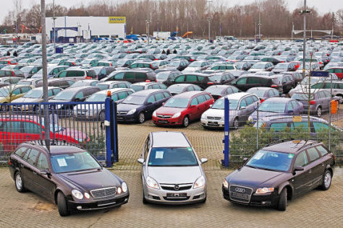
“Market for lemons”
George Arthur Akerlof (*1940)
The Market for Lemons: Quality Uncertainty and the Market Mechanism (1970)

Slide 182
Asymmetric information: Entrepreneurial approach
Enabling gains from cooperation

Slide 183
Asymmetric information: Market-based solutions
Screening
  Self-information
  Third-party advice
Signaling
  Reputation building
  Warranties
  Excesses
  Bonus-malus
Harmonizing interests
  Profit-sharing (bonus systems)
  Vertical integration

Slide 184
Outline
Introduction and Overview
Human Action and Social Coordination
Economic Order and Principles of Policy Making
Market Mechanisms and Government Interventions
Externalities and Public Goods
Competition and Antitrust Policy
Information Deficiencies
Redistribution and Social Policy

Slide 185
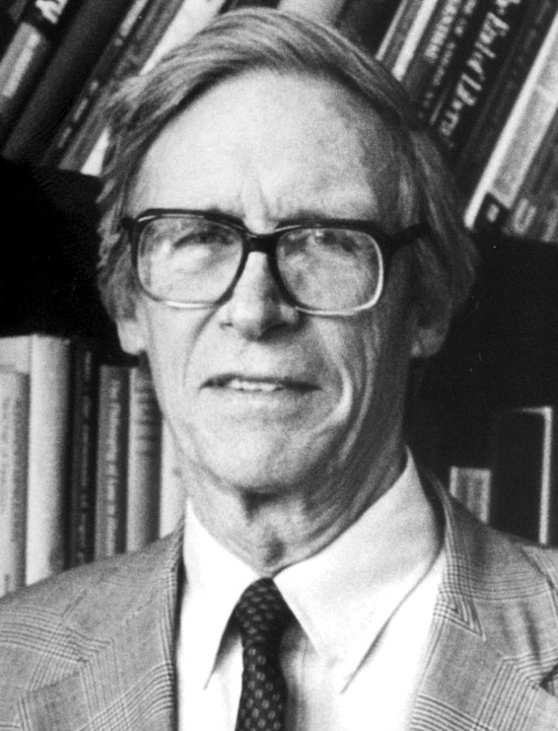

Redistribution: Pareto-improvements and the Rawlsian veil of ignorance
John B. Rawls (1921 – 2002)
A Theory of Justice (1971)
Source: Philosophyink (via Wikipedia)

Slide 186
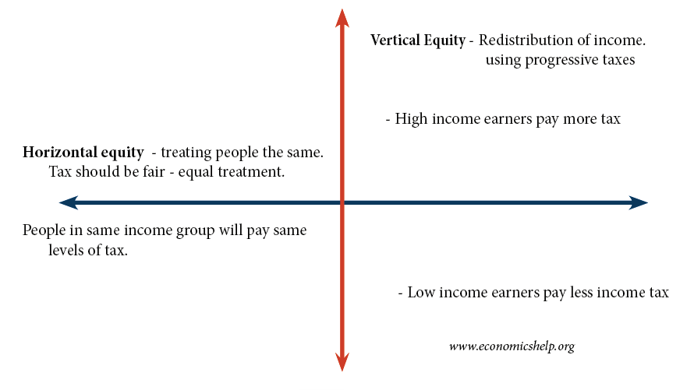
Horizontal vs. vertical equity

Slide 187
Principles of taxation: Benefits vs. ability-to-pay
Benefits principle
Ability-to-pay principle
  Horizontal equity (⇨ problem of loopholes)
  Vertical equity (⇨ equal “relative” burden)

Slide 188



Redistribution: Utility interdependence and Pareto-improvements
Utility possibility frontier: Conflict segment and cooperation segments

Slide 189
Charity: Solving the free-rider problem
Conditional income sharing
Two-stage voting scheme

